Slide 1
AI for Medicine
Lecture 05:
Ranked Retrieval– Part II
February 06, 2023
Mohammad Hammoud
Carnegie Mellon University in Qatar

Slide 2
Today…
Last Lecture:
  Ranked Retrieval – Part I
Today’s Session:
  Ranked Retrieval – Part II
Announcements:
  A1 grades are out
  A2 is out and due on Feb 15 by midnight

Slide 3
Outline
Ranked Retrieval
Recap
Background
The Vector Space Model
Cosine Similarity

Slide 4
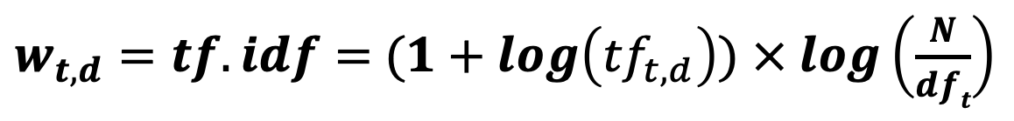
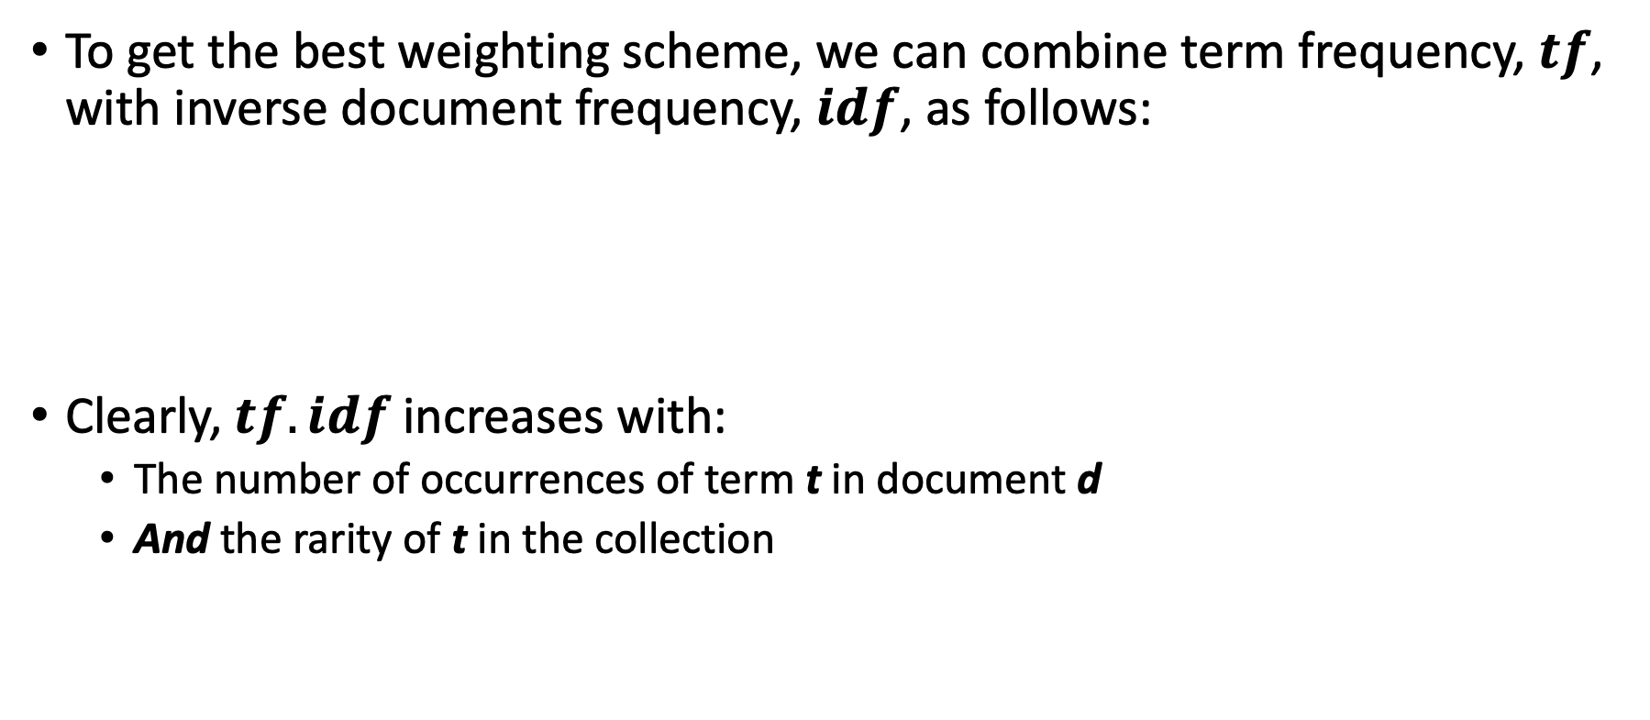
TF.IDF (or TF-IDF) Weighting
To get the best weighting scheme, we can combine term frequency, $tf$, with inverse document frequency, $idf$, as follows:
Clearly, $tf.idf$increases with:
  The number of occurrences of term t in document d
  And the rarity of t in the collection
$w_{t,d}=tf.idf=$ $(1+log\left({tf}_{t,d}\right))$ $× log\left(\frac{N}{dft}\right)$

Slide 5
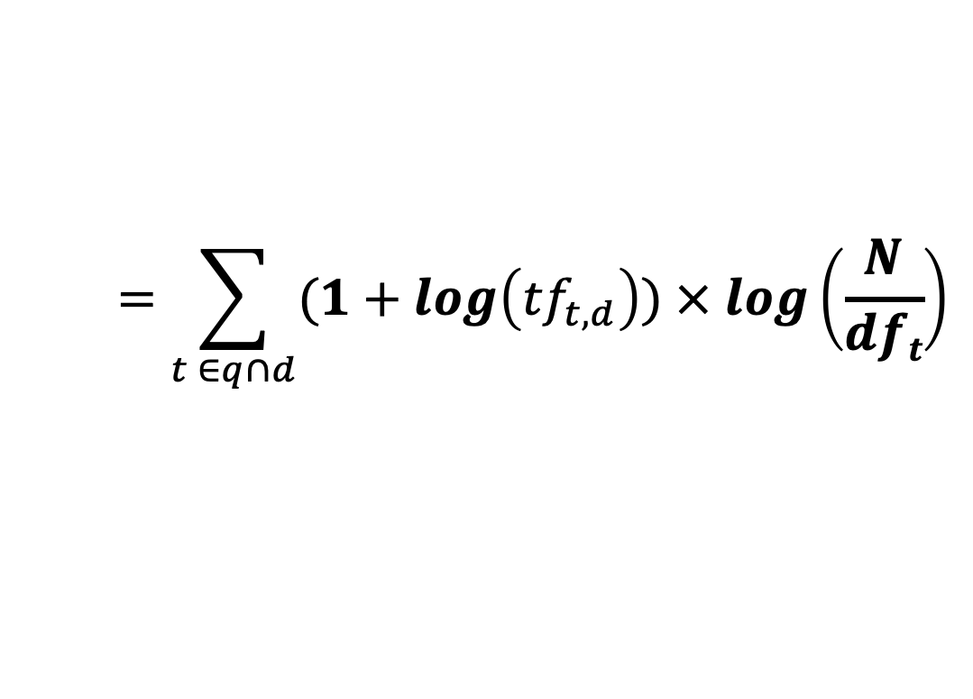
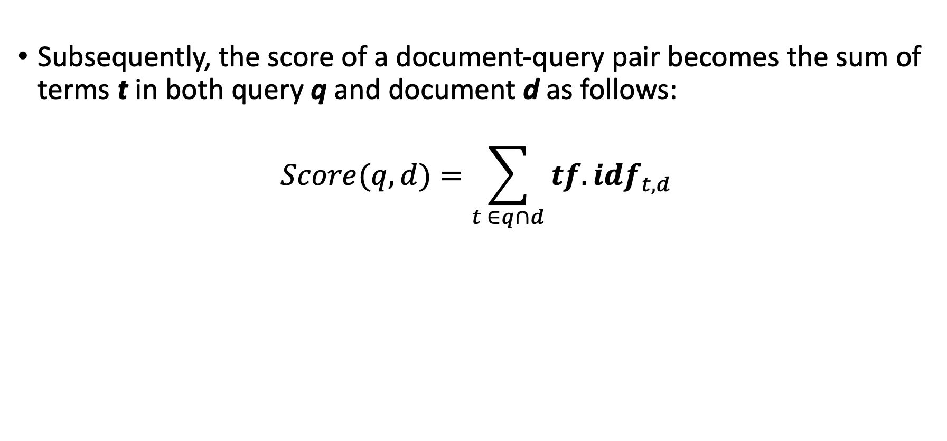
TF.IDF (or TF-IDF) Weighting
Subsequently, the score of a document-query pair becomes the sum of terms t in both query q and document d as follows:
$$Score(q,d)=\sum_{t ∈q∩d}{{tf.idf}_{t,d}}$$
$$=\sum_{t ∈q∩d}{(1+log\left({tf}_{t,d}\right)) × log\left(\frac{N}{dft}\right)}$$

Slide 6


TF.IDF: Example
Here is the term-document count matrix of our earlier example
 | Note 1 | Note 2 | Note 3 | Note 4 | Note 5 | Note 6
Thirst | 4 | 0 | 0 | 3 | 0 | 0
Fatigue | 1 | 0 | 0 | 1 | 0 | 0
Dizziness | 2 | 0 | 0 | 0 | 4 | 0
Fever | 0 | 5 | 0 | 0 | 0 | 0
Cough | 0 | 0 | 0 | 0 | 0 | 5
Headache | 0 | 2 | 3 | 0 | 0 | 0
$${tf}_{Headache, Note 3}=3>0$$
$${tf}_{Headache, Note 5}=0$$

Slide 7

TF.IDF: Example
And, here is the corresponding term-document log frequency matrix
 | Note 1 | Note 2 | Note 3 | Note 4 | Note 5 | Note 6
Thirst | 1.60205999 | 0 | 0 | 1.47712125 | 0 | 0
Fatigue | 1 | 0 | 0 | 1 | 0 | 0
Dizziness | 1.30103 | 0 | 0 | 0 | 1.60205999 | 0
Fever | 0 | 0 | 0 | 0 | 1 | 0
Cough | 0 | 1.69897 | 0 | 0 | 0 | 1.69897
Headache | 0 | 1.30103 | 1.47712125 | 0 | 0 | 0
$$w_{Headache, Note 3}={1+log(tf}_{Headache, Note 3})=1+log\left(3\right)=1.477$$
$$w_{Headache, Note 5}=0$$

Slide 8
TF.IDF: Example
And, here is the respective term-document TF.IDF matrix
 | Note 1 | Note 2 | Note 3 | Note 4 | Note 5 | Note 6
Thirst | 0.76437687 | 0 | 0 | 0.70476595 | 0 | 0
Fatigue | 0.47712125 | 0 | 0 | 0.47712125 | 0 | 0
Dizziness | 0.62074906 | 0 | 0 | 0 | 0.76437687 | 0
Fever | 0 | 0 | 0 | 0 | 0.77815125 | 0
Cough | 0 | 0.8106147 | 0 | 0 | 0 | 0.8106147
Headache | 0 | 0.62074906 | 0.70476595 | 0 | 0 | 0
$$w_{Headache, Note 3}={[1+log(tf}_{Headache, Note 3})]× log\left(\frac{N}{{df}_{Headache}}\right)=1.477× log\left(\frac{6}{2}\right)=0.7$$

Slide 9
TF.IDF: Example
And, here is the respective term-document TF.IDF matrix
 | Note 1 | Note 2 | Note 3 | Note 4 | Note 5 | Note 6
Thirst | 0.76437687 | 0 | 0 | 0.70476595 | 0 | 0
Fatigue | 0.47712125 | 0 | 0 | 0.47712125 | 0 | 0
Dizziness | 0.62074906 | 0 | 0 | 0 | 0.76437687 | 0
Fever | 0 | 0 | 0 | 0 | 0.77815125 | 0
Cough | 0 | 0.8106147 | 0 | 0 | 0 | 0.8106147
Headache | 0 | 0.62074906 | 0.70476595 | 0 | 0 | 0
Query: Cough and headache
$$Score\left(\left[Cough, Headache\right],Note 3\right)=0+0. 7=0. 7$$

Slide 10
Outline
Ranked Retrieval
Recap
Background
The Vector Space Model
Cosine Similarity

Slide 11




Vectors
A vector can be visually represented as an arrow
A vector can also be represented as an ordered list or a tuple by starting from its tail and asking how far away is its head in the:
  Horizontal direction
  Vertical direction
Head
= $\left[\begin{aligned}4 \\ 3\end{aligned}\right]$
$$\vec{v}$$
$$\vec{v}$$
3
Or:
$\vec{v}$
= (4, 3)
Tail
4

Slide 12

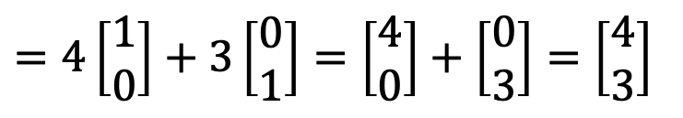







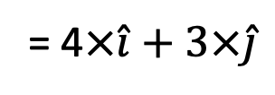


Unit Vectors
Any vector can also be represented as a sum of scaled up versions of unit vectors
It goes in the horizontal
direction only and has
length 1
= $\left[\begin{aligned}1 \\ 0\end{aligned}\right]$
$$\vec{v}$$
$$\hat{i}$$
$$\vec{v}$$
= $\left[\begin{aligned}4 \\ 3\end{aligned}\right]$
3
$$\hat{j}$$
= $\left[\begin{aligned}0 \\ 1\end{aligned}\right]$
It goes in the vertical
direction only and has
length 1
4
$$\hat{j}$$
$$\hat{i}$$
$$\vec{v}$$
= 4$×\hat{i}+3×\hat{j}$
$=4\left[\begin{aligned}1 \\ 0\end{aligned}\right]+3\left[\begin{aligned}0 \\ 1\end{aligned}\right]=\left[\begin{aligned}4 \\ 0\end{aligned}\right]+\left[\begin{aligned}0 \\ 3\end{aligned}\right]=\left[\begin{aligned}4 \\ 3\end{aligned}\right]$

Slide 13
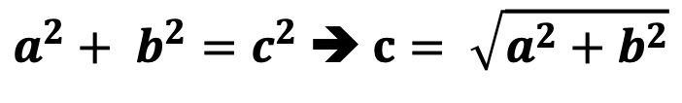

Vector Magnitude
How can we calculate the length (or magnitude) of a vector?
Pythagorean theorem:
c =
$$\vec{v}$$
$a^{2}+ b^{2}=c^{2}$➔ $c= \sqrt{a^{2}+b^{2}}$
b =
3
a =
4
Magnitude of the vector = $\left\|\vec{v}\right\|$ = $\sqrt{3^{2}+4^{2}}$ = $\sqrt{25}=5$
How can we keep vector, $\vec{v}$, pointing to the same direction, but change its magnitude to 1 (i.e., turn it into a unit vector)?

Slide 14
Vector Normalization
How can we construct a unit vector out of a given vector of any length?
Input:
Output:
Normalization
Vector of
any length
The vector with the same direction,
but with length 1

Slide 15




Vector Normalization
How can we construct a unit vector out of a given vector of any length?
Input:
Output:
Normalization:
$$\hat{v}= \frac{\vec{v}}{\left\|\vec{v}\right\|}$$
$$\vec{v}$$
$$\hat{v}$$
$$\frac{\vec{v}}{\left\|\vec{v}\right\|}$$

Slide 16


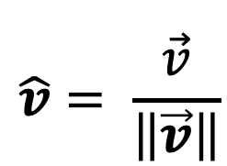




Vector Normalization
How can we construct a unit vector out of a given vector of any length?
$$\vec{v}$$
= $\left[\begin{aligned}4 \\ 3\end{aligned}\right]$
3
$$\hat{v}= \frac{\vec{v}}{\left\|\vec{v}\right\|}$$
= $\left[\begin{aligned}4/5 \\ 3/5\end{aligned}\right]$
$$\vec{v}$$
$$\hat{v}$$
4
Let us verify that its length is 1
‖$\vec{v}$‖ = $\sqrt{3^{2}+4^{2}}$ = $\sqrt{25}=5$

Slide 17
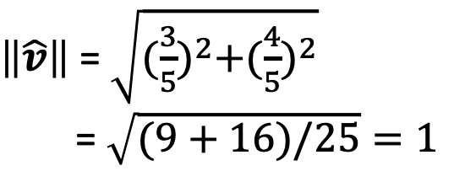
Vector Normalization
How can we construct a unit vector out of a given vector of any length?
$$\vec{v}$$
= $\left[\begin{aligned}4 \\ 3\end{aligned}\right]$
3
$$\hat{v}= \frac{\vec{v}}{\left\|\vec{v}\right\|}$$
= $\left[\begin{aligned}4/5 \\ 3/5\end{aligned}\right]$
$$\vec{v}$$
$$\hat{v}$$
4
$\left\|\hat{v}\right\|$ = $\sqrt{{(\frac{3}{5})}^{2}+{(\frac{4}{5})}^{2}}$
= $\sqrt{(9+16)/25}=1$
‖$\vec{v}$‖ = $\sqrt{3^{2}+4^{2}}$ = $\sqrt{25}=5$

Slide 18
Outline
Ranked Retrieval
Recap
Background
The Vector Space Model
Cosine Similarity

Slide 19
The Vector Space Model
We can view terms as axes in a vector space
 | Note 1 | Note 2 | Note 3 | Note 4 | Note 5 | Note 6
Thirst | 4 | 0 | 0 | 3 | 0 | 0
Fatigue | 1 | 0 | 0 | 1 | 0 | 0
Dizziness | 2 | 0 | 0 | 0 | 4 | 0
Fever | 0 | 0 | 0 | 0 | 0 | 0
Cough | 0 | 5 | 0 | 0 | 0 | 5
Headache | 0 | 2 | 3 | 0 | 0 | 0
An axis

Slide 20
The Vector Space Model
We can view terms as axes in a vector space
Cough

Slide 21
The Vector Space Model
We can view terms as axes in a vector space
 | Note 1 | Note 2 | Note 3 | Note 4 | Note 5 | Note 6
Thirst | 4 | 0 | 0 | 3 | 0 | 0
Fatigue | 1 | 0 | 0 | 1 | 0 | 0
Dizziness | 2 | 0 | 0 | 0 | 4 | 0
Fever | 0 | 0 | 0 | 0 | 0 | 0
Cough | 0 | 5 | 0 | 0 | 0 | 5
Headache | 0 | 2 | 3 | 0 | 0 | 0
An axis

Slide 22
The Vector Space Model
We can view terms as axes in a vector space
Cough
Headache

Slide 23
The Vector Space Model
We can also view documents (e.g., medical notes) as vectors in the same vector space
 | Note 1 | Note 2 | Note 3 | Note 4 | Note 5 | Note 6
Thirst | 4 | 0 | 0 | 3 | 0 | 0
Fatigue | 1 | 0 | 0 | 1 | 0 | 0
Dizziness | 2 | 0 | 0 | 0 | 4 | 0
Fever | 0 | 0 | 0 | 0 | 0 | 0
Cough | 0 | 5 | 0 | 0 | 0 | 5
Headache | 0 | 2 | 3 | 0 | 0 | 0
Vector

Slide 24
The Vector Space Model
We can also view documents (e.g., medical notes) as vectors in the same vector space
Cough
Note 3
Headache

Slide 25
The Vector Space Model
We can also view documents (e.g., medical notes) as vectors in the same vector space
 | Note 1 | Note 2 | Note 3 | Note 4 | Note 5 | Note 6
Thirst | 4 | 0 | 0 | 3 | 0 | 0
Fatigue | 1 | 0 | 0 | 1 | 0 | 0
Dizziness | 2 | 0 | 0 | 0 | 4 | 0
Fever | 0 | 0 | 0 | 0 | 0 | 0
Cough | 0 | 5 | 0 | 0 | 0 | 5
Headache | 0 | 2 | 3 | 0 | 0 | 0
Vector

Slide 26
The Vector Space Model
We can also view documents (e.g., medical notes) as vectors in the same vector space
Cough
Note 6
Note 3
Headache

Slide 27
The Vector Space Model
We can also view documents (e.g., medical notes) as vectors in the same vector space
 | Note 1 | Note 2 | Note 3 | Note 4 | Note 5 | Note 6
Thirst | 4 | 0 | 0 | 3 | 0 | 0
Fatigue | 1 | 0 | 0 | 1 | 0 | 0
Dizziness | 2 | 0 | 0 | 0 | 4 | 0
Fever | 0 | 0 | 0 | 0 | 0 | 0
Cough | 0 | 5 | 0 | 0 | 0 | 5
Headache | 0 | 2 | 3 | 0 | 0 | 0
Vector

Slide 28
The Vector Space Model
We can also view documents (e.g., medical notes) as vectors in the same vector space
Note 2
Cough
Note 6
Note 3
Headache

Slide 29
The Vector Space Model
Lastly, we can further view queries as vectors in the same vector space
 | Note 1 | Note 2 | Note 3 | Note 4 | Note 5 | Note 6 | Query
Thirst | 4 | 0 | 0 | 3 | 0 | 0 | 0
Fatigue | 1 | 0 | 0 | 1 | 0 | 0 | 0
Dizziness | 2 | 0 | 0 | 0 | 4 | 0 | 0
Fever | 0 | 0 | 0 | 0 | 0 | 0 | 0
Cough | 0 | 5 | 0 | 0 | 0 | 5 | 5
Headache | 0 | 2 | 3 | 0 | 0 | 0 | 1
Vector

Slide 30
The Vector Space Model
Lastly, we can further view queries as vectors in the same vector space
Note 2
Cough
Note 6
Query
Note 3
Headache

Slide 31
The Vector Space Model
Subsequently, we can rank documents based on their proximity to the query in the vector space
  Proximity is the inverse of distance
As a result, documents that are more relevant to the query will be ranked higher than the documents that are less relevant to the query
Clearly, this contrasts with the Boolean model where documents are either in or out!

Slide 32
Ranking Based on Distance
Let us rank the documents (i.e., notes) based on the Euclidean distance (denoted as Ed) from the query
Note 2
Cough
Note 6
Ed(Query, Note 2)
Ed(Query, Note 2) > Ed(Query, Note 3)
although Query is more similar
to Note 2 than to Note 3!
Query
Ed(Query, Note 3)
Note 3
Headache

Slide 33
Ranking Based on Distance
Let us rank the documents (i.e., notes) based on the Euclidean distance (denoted as Ed) from the query
Note 2
Cough
Note 6
Ed(Query, Note 2)
Ed(Query, Note 6)
Ed(Query, Note 2) > Ed(Query, Note 6)
although Query is more similar
to Note 2 than to Note 6!
Query
Ranking based on Euclidean distance is not effective!
Note 3
Headache

Slide 34
If Not Distance then What?
Let us take a document, d, and append it to itself
  Call the resultant document, d’
“Semantically” d and d’ have the same content although the distance between them could be very large!
Note, however, that the angle between d and d’ in the vector space is 0, corresponding to maximal similarity
Idea: Rank documents based on angles rather than distances!

Slide 35
Outline
Ranked Retrieval
Recap
Background
The Vector Space Model
Cosine Similarity

Slide 36
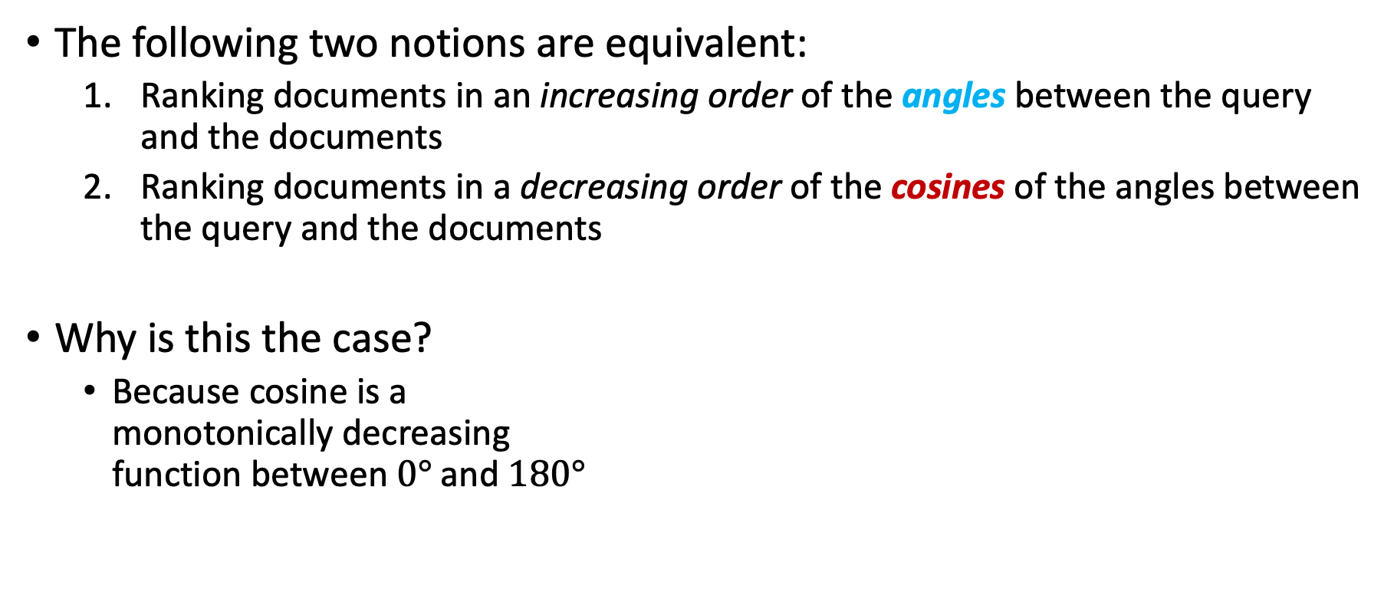



Angle vs. Cosine
The following two notions are equivalent:
  Ranking documents in an increasing order of the angles between the query and the documents
  Ranking documents in a decreasing order of the cosines of the angles between the query and the documents
Why is this the case?
  Because cosine is a
  monotonically decreasing
  function between $0°$and $180°$
Cosine = 1
Cosine
Cosine = 0
Angle
$$0°$$
$$90°$$
$$180°$$
Cosine = -1

Slide 37

Angle vs. Cosine
The following two notions are equivalent:
  Ranking documents in an increasing order of the angles between the query and the documents
  Ranking documents in a decreasing order of the cosines of the angles between the query and the documents
Why is this the case?
  Because cosine is a
  monotonically decreasing
  function between $0°$and $180°$
Cosine = 1
Cosine
Cosine
decreases
As the angle increases till $180°$
Cosine = 0
Angle
$$0°$$
$$90°$$
$$180°$$
Cosine = -1

Slide 38
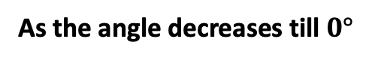
Angle vs. Cosine
The following two notions are equivalent:
  Ranking documents in an increasing order of the angles between the query and the documents
  Ranking documents in a decreasing order of the cosines of the angles between the query and the documents
Why is this the case?
  Because cosine is a
  monotonically decreasing
  function between $0°$and $180°$
Cosine = 1
Cosine
Cosine
increases
As the angle decreases till $0°$
Cosine = 0
Angle
$$0°$$
$$90°$$
$$180°$$
Cosine = -1

Slide 39

Angle vs. Cosine
The following two notions are equivalent:
  Ranking documents in an increasing order of the angles between the query and the documents
  Ranking documents in a decreasing order of the cosines of the angles between the query and the documents
Why is this the case?
  Because cosine is a
  monotonically decreasing
  function between $0°$and $180°$
The larger the cosine, the smaller the angle in the interval
[$0°$, $180°$]

Slide 40
Angle vs. Cosine
The following two notions are equivalent:
  Ranking documents in an increasing order of the angles between the query and the documents
  Ranking documents in a decreasing order of the cosines of the angles between the query and the documents
Why is this the case?
  Because cosine is a
  monotonically decreasing
  function between $0°$and $180°$
But, why should we use cosines instead of angles?

Slide 41
Angle vs. Cosine
The following two notions are equivalent:
  Ranking documents in an increasing order of the angles between the query and the documents
  Ranking documents in a decreasing order of the cosines of the angles between the query and the documents
Why is this the case?
  Because cosine is a
  monotonically decreasing
  function between $0°$and $180°$
There is a very efficient way of computing cosines using vector arithmetic

Slide 42
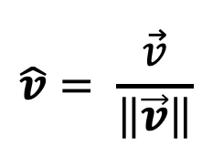
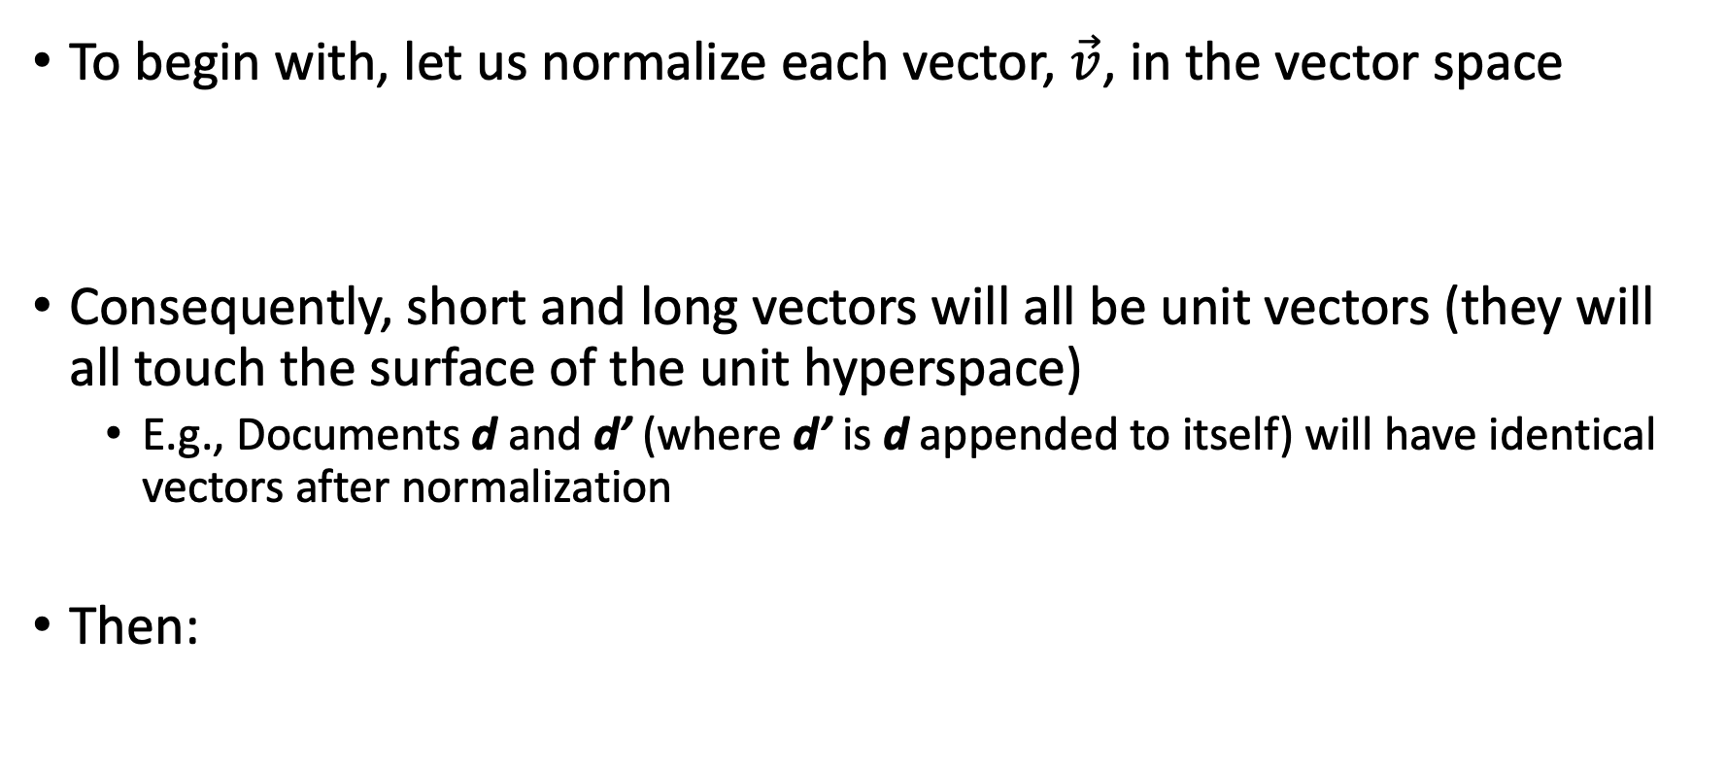

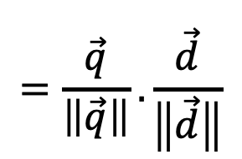
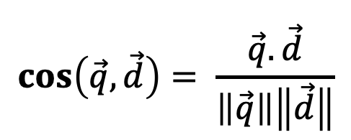
Cosine Similarity
To begin with, let us normalize each vector, $\vec{v}$, in the vector space
Consequently, short and long vectors will all be unit vectors (they will all touch the surface of the unit hyperspace)
  E.g., Documents d and d’ (where d’ is d appended to itself) will have identical vectors after normalization
Then:
$$\hat{v}= \frac{\vec{v}}{\left\|\vec{v}\right\|}$$
Unit vector
To compute cosine, we
simply multiply two unit
vectors
$$\cos\left(\vec{q},\vec{d}\right)= \frac{\vec{q}.\vec{d}}{\left\|\vec{q}\right\|\left\|\vec{d}\right\|}$$
$$=\frac{\vec{q}}{\left\|\vec{q}\right\|}.\frac{\vec{d}}{\left\|\vec{d}\right\|}$$
$$=\hat{q}.\hat{d}$$
Unit vector

Slide 43
Cosine Similarity Illustrated
Un-normalized Vectors
Normalized Vectors
Note 2
Cough
Cough
Note 6
Note 6
Unit Hyperspace
Query
Query
Note 2
Note 3
Note 3
Headache
Headache

Slide 44





Cosine Similarity And Ranking Illustrated
The smaller the angle,
the larger the cosine:
Cough
Note 6
$$θ_{1}<θ_{0}<θ_{2}$$
Query
Note 2
$${⇒cos(θ}_{1})>{cos(θ}_{0})>{cos(θ}_{2})$$
Rank By Cosine in Decreasing Order
Note 2
Note 6
Note 3
$$θ_{0}$$
$$θ_{1}$$
Note 3
$$θ_{2}$$
Headache

Slide 45
Example
Here is the term-document TF.IDF matrix of our running example, with the query being represented as a vector as well
 | Note 1 | Note 2 | Note 3 | Note 4 | Note 5 | Note 6 | Query
Thirst | 0.76437687 | 0 | 0 | 0.70476595 | 0 | 0 | 0
Fatigue | 0.47712125 | 0 | 0 | 0.47712125 | 0 | 0 | 0
Dizziness | 0.62074906 | 0 | 0 | 0 | 0.76437687 | 0 | 0
Fever | 0 | 0 | 0 | 0 | 0.77815125 | 0 | 0
Cough | 0 | 0.8106147 | 0 | 0 | 0 | 0.8106147 | 0.8106147
Headache | 0 | 0.62074906 | 0.70476595 | 0 | 0 | 0 | 0.47712125

Slide 46
Example
Here is the corresponding term-document normalized TF.IDF matrix
 | Note 1 | Note 2 | Note 3 | Note 4 | Note 5 | Note 6 | Query
Thirst | 0.69857948 | 0 | 0 | 0.82808279 | 0 | 0 | 0
Fatigue | 0.43605076 | 0 | 0 | 0.56060583 | 0 | 0 | 0
Dizziness | 0.56731512 | 0 | 0 | 0 | 0.70076456 | 0 | 0
Fever | 0 | 0 | 0 | 0 | 0.71339262 | 0 | 0
Cough | 0 | 0.79394779 | 0 | 0 | 0 | 1 | 0.86179988
Headache | 0 | 0.60798595 | 1 | 0 | 0 | 0 | 0.50724843
Rank (Score)
Note 1 (0)
$$\operatorname{Cos}\left(Query, Note 1\right)=\left(0.69×0\right)+\left(0.43×0\right)+\left(0.56×0\right)+\left(0×0\right)+\left(0×0.86\right)+\left(0×0.5\right)=0$$

Slide 47
Example
Here is the corresponding term-document normalized TF.IDF matrix
 | Note 1 | Note 2 | Note 3 | Note 4 | Note 5 | Note 6 | Query
Thirst | 0.69857948 | 0 | 0 | 0.82808279 | 0 | 0 | 0
Fatigue | 0.43605076 | 0 | 0 | 0.56060583 | 0 | 0 | 0
Dizziness | 0.56731512 | 0 | 0 | 0 | 0.70076456 | 0 | 0
Fever | 0 | 0 | 0 | 0 | 0.71339262 | 0 | 0
Cough | 0 | 0.79394779 | 0 | 0 | 0 | 1 | 0.86179988
Headache | 0 | 0.60798595 | 1 | 0 | 0 | 0 | 0.50724843
Rank (Score)
Note 1 (0)
$$\operatorname{Cos}\left(Query, Note 2\right)=\left(0×0\right)+\left(0×0\right)+\left(0×0\right)+\left(0×0\right)+\left(0.79×0.86\right)+\left(0.6×0.5\right)=0.99$$

Slide 48
Example
Here is the corresponding term-document normalized TF.IDF matrix
 | Note 1 | Note 2 | Note 3 | Note 4 | Note 5 | Note 6 | Query
Thirst | 0.69857948 | 0 | 0 | 0.82808279 | 0 | 0 | 0
Fatigue | 0.43605076 | 0 | 0 | 0.56060583 | 0 | 0 | 0
Dizziness | 0.56731512 | 0 | 0 | 0 | 0.70076456 | 0 | 0
Fever | 0 | 0 | 0 | 0 | 0.71339262 | 0 | 0
Cough | 0 | 0.79394779 | 0 | 0 | 0 | 1 | 0.86179988
Headache | 0 | 0.60798595 | 1 | 0 | 0 | 0 | 0.50724843
Rank (Score)
Note 2 (0.99)
Note 1 (0)
$$\operatorname{Cos}\left(Query, Note 2\right)=\left(0×0\right)+\left(0×0\right)+\left(0×0\right)+\left(0×0\right)+\left(0.79×0.86\right)+\left(0.6×0.5\right)=0.99$$

Slide 49
Example
Here is the corresponding term-document normalized TF.IDF matrix
 | Note 1 | Note 2 | Note 3 | Note 4 | Note 5 | Note 6 | Query
Thirst | 0.69857948 | 0 | 0 | 0.82808279 | 0 | 0 | 0
Fatigue | 0.43605076 | 0 | 0 | 0.56060583 | 0 | 0 | 0
Dizziness | 0.56731512 | 0 | 0 | 0 | 0.70076456 | 0 | 0
Fever | 0 | 0 | 0 | 0 | 0.71339262 | 0 | 0
Cough | 0 | 0.79394779 | 0 | 0 | 0 | 1 | 0.86179988
Headache | 0 | 0.60798595 | 1 | 0 | 0 | 0 | 0.50724843
Rank (Score)
Note 2 (0.99)
Note 1 (0)
$$\operatorname{Cos}\left(Query, Note 3\right)=\left(0×0\right)+\left(0×0\right)+\left(0×0\right)+\left(0×0\right)+\left(0×0.86\right)+\left(1×0.5\right)=0.5$$

Slide 50
Example
Here is the corresponding term-document normalized TF.IDF matrix
 | Note 1 | Note 2 | Note 3 | Note 4 | Note 5 | Note 6 | Query
Thirst | 0.69857948 | 0 | 0 | 0.82808279 | 0 | 0 | 0
Fatigue | 0.43605076 | 0 | 0 | 0.56060583 | 0 | 0 | 0
Dizziness | 0.56731512 | 0 | 0 | 0 | 0.70076456 | 0 | 0
Fever | 0 | 0 | 0 | 0 | 0.71339262 | 0 | 0
Cough | 0 | 0.79394779 | 0 | 0 | 0 | 1 | 0.86179988
Headache | 0 | 0.60798595 | 1 | 0 | 0 | 0 | 0.50724843
Rank (Score)
Note 2 (0.99)
Note 3 (0.5)
Note 1 (0)
$$\operatorname{Cos}\left(Query, Note 3\right)=\left(0×0\right)+\left(0×0\right)+\left(0×0\right)+\left(0×0\right)+\left(0×0.86\right)+\left(1×0.5\right)=0.5$$

Slide 51
Example
Here is the corresponding term-document normalized TF.IDF matrix
 | Note 1 | Note 2 | Note 3 | Note 4 | Note 5 | Note 6 | Query
Thirst | 0.69857948 | 0 | 0 | 0.82808279 | 0 | 0 | 0
Fatigue | 0.43605076 | 0 | 0 | 0.56060583 | 0 | 0 | 0
Dizziness | 0.56731512 | 0 | 0 | 0 | 0.70076456 | 0 | 0
Fever | 0 | 0 | 0 | 0 | 0.71339262 | 0 | 0
Cough | 0 | 0.79394779 | 0 | 0 | 0 | 1 | 0.86179988
Headache | 0 | 0.60798595 | 1 | 0 | 0 | 0 | 0.50724843
Rank (Score)
Note 2 (0.99)
Note 3 (0.5)
Note 1 (0)
$$\operatorname{Cos}\left(Query, Note 4\right)=\left(0.82×0\right)+\left(0.56×0\right)+\left(0×0\right)+\left(0×0\right)+\left(0×0.86\right)+\left(0×0.5\right)=0$$

Slide 52
Example
Here is the corresponding term-document normalized TF.IDF matrix
 | Note 1 | Note 2 | Note 3 | Note 4 | Note 5 | Note 6 | Query
Thirst | 0.69857948 | 0 | 0 | 0.82808279 | 0 | 0 | 0
Fatigue | 0.43605076 | 0 | 0 | 0.56060583 | 0 | 0 | 0
Dizziness | 0.56731512 | 0 | 0 | 0 | 0.70076456 | 0 | 0
Fever | 0 | 0 | 0 | 0 | 0.71339262 | 0 | 0
Cough | 0 | 0.79394779 | 0 | 0 | 0 | 1 | 0.86179988
Headache | 0 | 0.60798595 | 1 | 0 | 0 | 0 | 0.50724843
Rank (Score)
Note 2 (0.99)
Note 3 (0.5)
Note 1 (0)
Note 4 (0)
$$\operatorname{Cos}\left(Query, Note 4\right)=\left(0.82×0\right)+\left(0.56×0\right)+\left(0×0\right)+\left(0×0\right)+\left(0×0.86\right)+\left(0×0.5\right)=0$$

Slide 53
Example
Here is the corresponding term-document normalized TF.IDF matrix
 | Note 1 | Note 2 | Note 3 | Note 4 | Note 5 | Note 6 | Query
Thirst | 0.69857948 | 0 | 0 | 0.82808279 | 0 | 0 | 0
Fatigue | 0.43605076 | 0 | 0 | 0.56060583 | 0 | 0 | 0
Dizziness | 0.56731512 | 0 | 0 | 0 | 0.70076456 | 0 | 0
Fever | 0 | 0 | 0 | 0 | 0.71339262 | 0 | 0
Cough | 0 | 0.79394779 | 0 | 0 | 0 | 1 | 0.86179988
Headache | 0 | 0.60798595 | 1 | 0 | 0 | 0 | 0.50724843
Rank (Score)
Note 2 (0.99)
Note 3 (0.5)
Note 1 (0)
Note 4 (0)
$$\operatorname{Cos}\left(Query, Note 5\right)=\left(0×0\right)+\left(0×0\right)+\left(0.7×0\right)+\left(0.71×0\right)+\left(0×0.86\right)+\left(0×0.5\right)=0$$

Slide 54
Example
Here is the corresponding term-document normalized TF.IDF matrix
 | Note 1 | Note 2 | Note 3 | Note 4 | Note 5 | Note 6 | Query
Thirst | 0.69857948 | 0 | 0 | 0.82808279 | 0 | 0 | 0
Fatigue | 0.43605076 | 0 | 0 | 0.56060583 | 0 | 0 | 0
Dizziness | 0.56731512 | 0 | 0 | 0 | 0.70076456 | 0 | 0
Fever | 0 | 0 | 0 | 0 | 0.71339262 | 0 | 0
Cough | 0 | 0.79394779 | 0 | 0 | 0 | 1 | 0.86179988
Headache | 0 | 0.60798595 | 1 | 0 | 0 | 0 | 0.50724843
Rank (Score)
Note 2 (0.99)
Note 3 (0.5)
Note 1 (0)
Note 4 (0)
Note 5 (0)
$$\operatorname{Cos}\left(Query, Note 5\right)=\left(0×0\right)+\left(0×0\right)+\left(0.7×0\right)+\left(0.71×0\right)+\left(0×0.86\right)+\left(0×0.5\right)=0$$

Slide 55
Example
Here is the corresponding term-document normalized TF.IDF matrix
 | Note 1 | Note 2 | Note 3 | Note 4 | Note 5 | Note 6 | Query
Thirst | 0.69857948 | 0 | 0 | 0.82808279 | 0 | 0 | 0
Fatigue | 0.43605076 | 0 | 0 | 0.56060583 | 0 | 0 | 0
Dizziness | 0.56731512 | 0 | 0 | 0 | 0.70076456 | 0 | 0
Fever | 0 | 0 | 0 | 0 | 0.71339262 | 0 | 0
Cough | 0 | 0.79394779 | 0 | 0 | 0 | 1 | 0.86179988
Headache | 0 | 0.60798595 | 1 | 0 | 0 | 0 | 0.50724843
Rank (Score)
Note 2 (0.99)
Note 3 (0.5)
Note 1 (0)
Note 4 (0)
Note 5 (0)
$\operatorname{Cos}\left(Query, Note 6\right)=\left(0×0\right)+\left(0×0\right)+\left(0×0\right)+\left(0×0\right)+\left(1×0.86\right)+\left(0×0.5\right)=0$.86

Slide 56
Example
Here is the corresponding term-document normalized TF.IDF matrix
 | Note 1 | Note 2 | Note 3 | Note 4 | Note 5 | Note 6 | Query
Thirst | 0.69857948 | 0 | 0 | 0.82808279 | 0 | 0 | 0
Fatigue | 0.43605076 | 0 | 0 | 0.56060583 | 0 | 0 | 0
Dizziness | 0.56731512 | 0 | 0 | 0 | 0.70076456 | 0 | 0
Fever | 0 | 0 | 0 | 0 | 0.71339262 | 0 | 0
Cough | 0 | 0.79394779 | 0 | 0 | 0 | 1 | 0.86179988
Headache | 0 | 0.60798595 | 1 | 0 | 0 | 0 | 0.50724843
Rank (Score)
Note 2 (0.99)
Note 6 (0.86)
Note 3 (0.5)
Note 1 (0)
Note 4 (0)
Note 5 (0)
$\operatorname{Cos}\left(Query, Note 6\right)=\left(0×0\right)+\left(0×0\right)+\left(0×0\right)+\left(0×0\right)+\left(1×0.86\right)+\left(0×0.5\right)=0$.86

Slide 57
Next Lecture…
Machine Learning- Core Concept

Slide 58
References
Schütze, Hinrich, Christopher D. Manning, and Prabhakar Raghavan. Introduction to information retrieval. Vol. 39. Cambridge: Cambridge University Press, 2008.

